Slide 1

Final Presentation on Project on
“SMART WHEELCHAIR FOR PARALYZED”
Presented by
KNR18EE024 JASIRA T P
KNR18EE034 NAYANA RAMESHAN
KNR18EE046 SHRAVAN SREEDEEP
KNR18EE048 SOORYA P
under the guidance of
Dr. C SREEKUMAR
DEPARTMENT OF ELECTRICAL & ELECTRONICS ENGINEERING
GOVT. COLLEGE OF ENGINEERING KANNUR- 670563
June 2022

Slide 2
OVERVIEW
Introduction Objectives Literature Review Schematic Diagram Smart Wheelchair Raspberry Pi Configuration Interface Eye Tracking Program | Simulation Prototype Working of Wheelchair Estimation of Components Limitations Future Scopes Conclusion Reference

Slide 3
INTRODUCTION
Paralyzed stroke patients are unable to normally communicate with their environment.
Part of their body that is under their control is their eyeballs.
Basic day to day operations are switching on basic devices like fan, bulb etc.
Smart Wheel Chair is the solution that we are proposing for these problems.

Slide 4
OBJECTIVES
To control the electric wheel chair by tracking eye movements.
To design and implement an electric wheelchair.
To track eye movement and control basic devices like bulb, fan etc.

Slide 5
LITERATURE REVIEW
[1] Diksha Raj, Anish Kalra, Sreejith Krishna N, Suhriday Roy, Dr. Shreenath K N, “Wagon - The Smart Wheelchair”, JETIR, August 2021, Vol.8, Issue 8
It comprises a wheelchair that works on hand gestures, voice command inputs, app inputs(Keypad), and head movements input for locomotion of the differently abled persons
Project can be upgraded in terms of speed and the lag can be overcome by replacing them with more advanced tools and sensors.

Slide 6
LITERATURE REVIEW
[2]Dola Das, Prottoy Saha and Nawshin Tabassum, “Real Time Distance and Mobility Detection of Obstacles Using a Smart Multisensor Framework for Visually Impaired People”, IEEE, 2020
The Ultrasonic Sonar sensors measure the distance and velocity of the movable object from the cane.
System notifies the user using vibration and audio message depending on the direction of the coming objects, distance and velocity.

Slide 7
LITERATURE REVIEW
[3]Tan Kian Hou, Yagasena and Chelladurai, “Arduino based voice controlled wheelchair”, IEEE, 2019
Smart motorized voice controlled wheelchair.
Voice command controls the movements of the wheelchair.
Microcontroller used is Arduino Uno.

Slide 8
LITERATURE REVIEW
[4]Ahmad F. Klaib, Nawaf . Alsrehin, Wasen Y. Melhem, Haneen Bashtawi, Aws A. Magableh, “Eye Tracking Algorithms, Techniques, Tools, and Applications with an Emphasis on Machine Learning and Internet of Things Technologies”, September 2020.
Machine learning and the Internet of Things are essential factors in the development of eye tracking applications.
This eye tracking techniques have more accurate detection results compared with traditional event-detection methods.

Slide 9
LITERATURE REVIEW
[5] Mohammed Hayyan Al Sibai, Sulastri Abdhul Manap, “A Study on Smart
Wheelchair Systems”, Research Gate Dec 2015
Presented different smart technologies for wheelchairs.
The human - machine interface and the navigation methods and devices, were the two key areas of concentration.

Slide 10
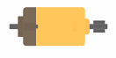
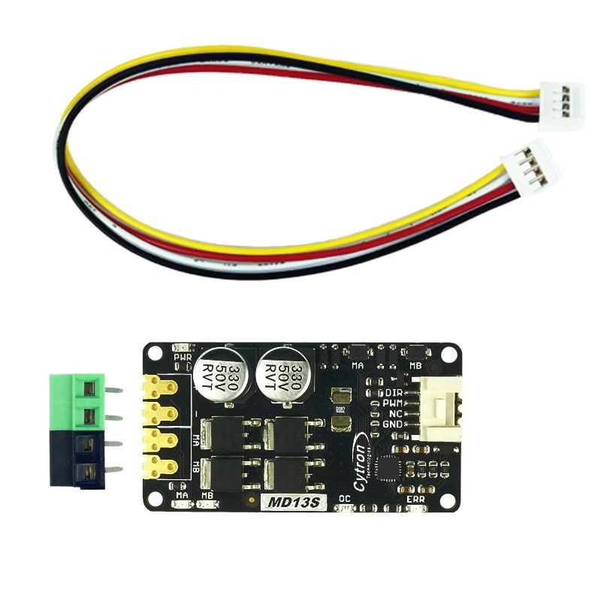
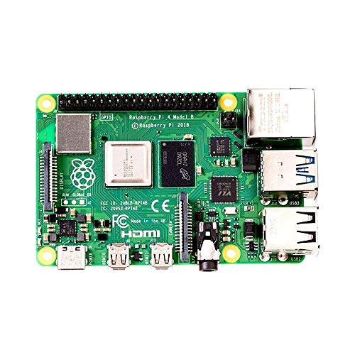
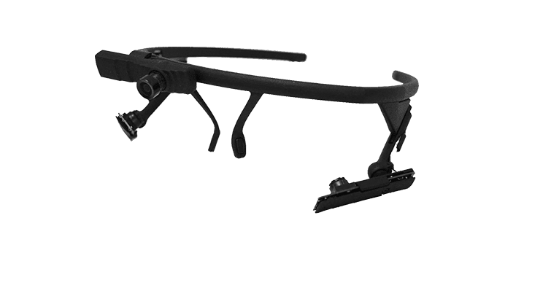

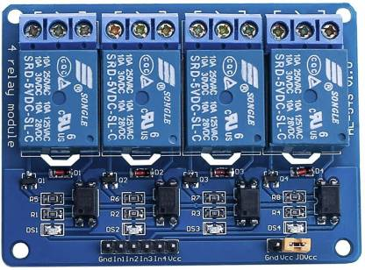
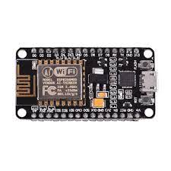
SCHEMATIC DIAGRAM
LEFT MOTOR
DC MOTOR DRIVER
CAMERA MODULE
RIGHT MOTOR
RASPBERRY PI 4
RELAY CIRCUIT
NODE MCU
Fig 1. Block Diagram of Smart Wheelchair

Slide 11
SMART WHEELCHAIR
The whole project is divided into 3 parts:
Wheel Chair
Eye tracking module using Raspberry Pi 4
Home automation system using Node MCU

Slide 12
SMART WHEELCHAIR
Eye tracking module using Raspberry Pi 4:
Camera Module is used to capture eye movements.
The eye movement is tracked using the python eye tracking model using Raspberry Pi 4.
The position of the pupil is transferred to Node MCU.

Slide 13
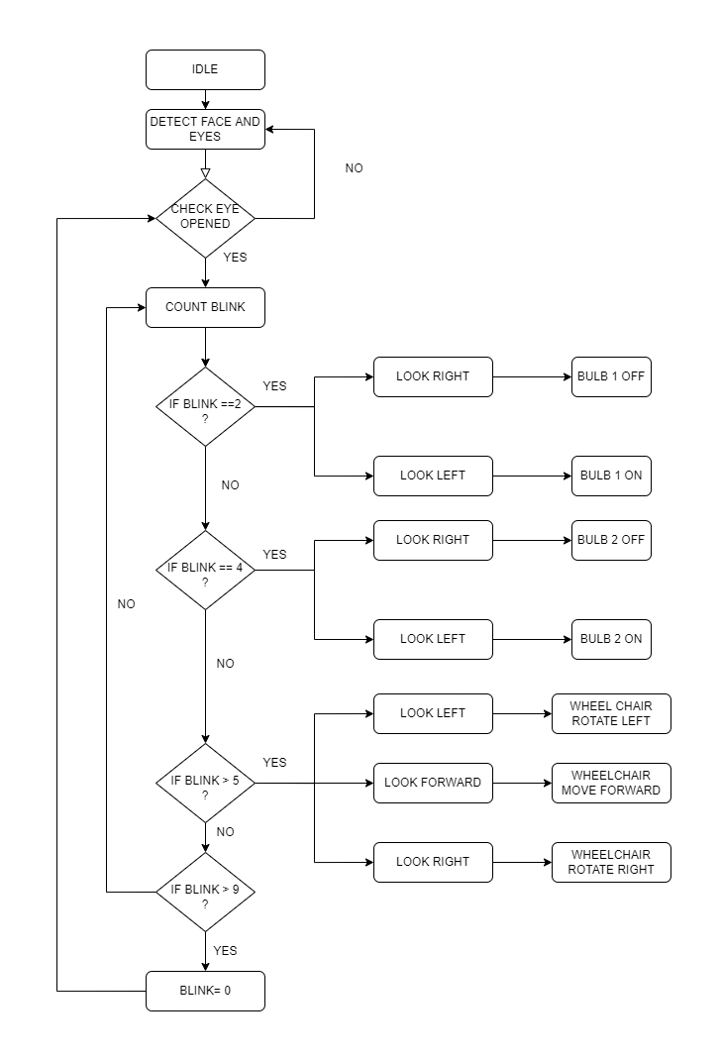
Fig 2. Flow Chart of Eye Tracking Program

Slide 14
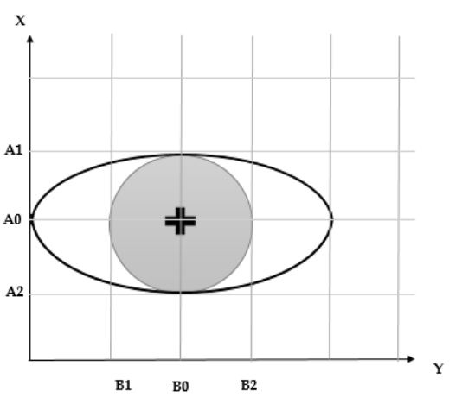
SMART WHEELCHAIR
Fig 3. Detection of Pupil in Tracking Program

Slide 15
SMART WHEELCHAIR
Wheel Chair
Wheel chair is also controlled on the basis of the control signal received from Raspberry Pi 4.
The wheel chair operates at low speed for safety.

Slide 16
SMART WHEELCHAIR
Home automation system using Node MCU:
From the position received from Raspberry Pi 4, appropriate decision is taken by the Node MCU.
Control by Node MCU include the switches of light and fan.

Slide 17
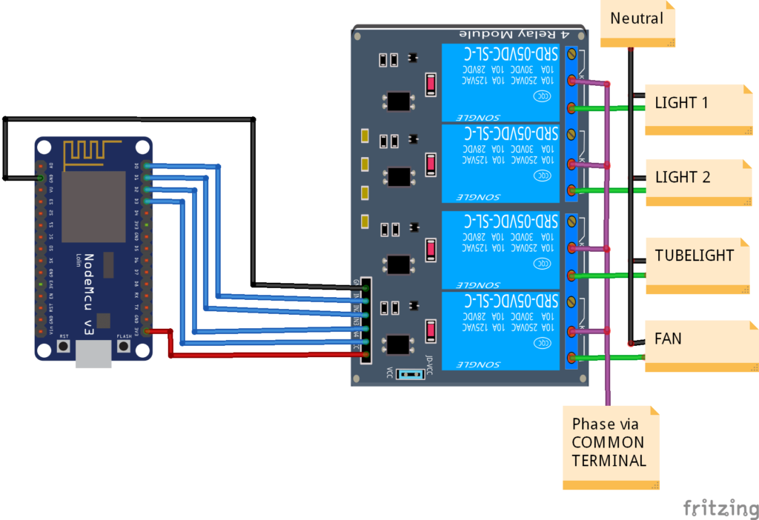
SMART WHEELCHAIR
Fig 4. Home Automation System Using Node MCU and Bluetooth Module

Slide 18
RASPBERRY PI 4 CONFIGURATION
Materials required:
Raspberry Pi 4
RJ45 LAN cable
32GB SD card and adapter
Software required:
Raspberry Pi OS
VNC Viewer and VNC Server
PuTTY Software

Slide 19

RASPBERRY PI INTERFACE
Fig 5. Raspbian OS Desktop Interface

Slide 20
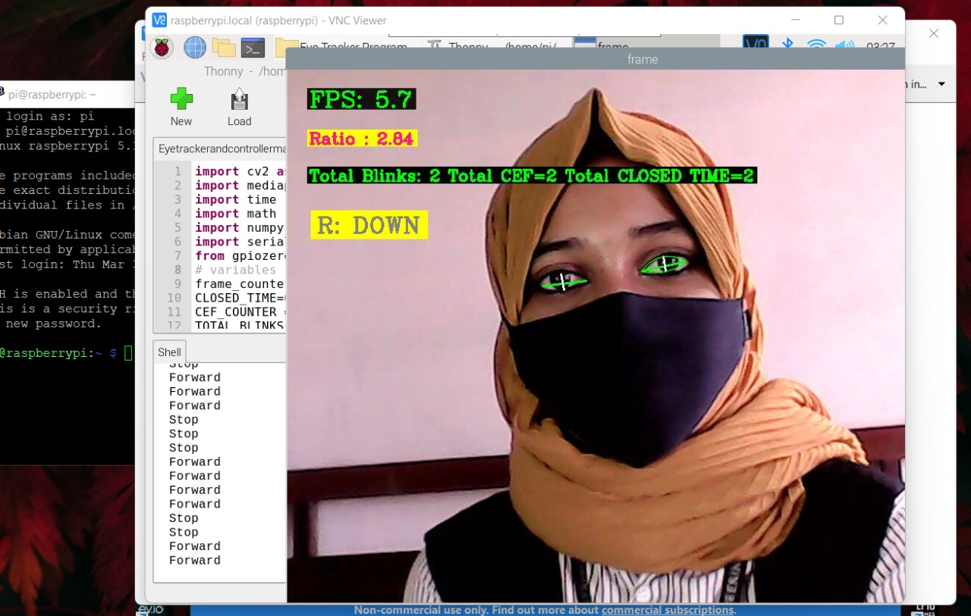
EYE TRACKING PROGRAM
Tested eye tracking program on Raspberry Pi 4
Fig 6. Eye tracking program on Raspberry Pi 4

Slide 21
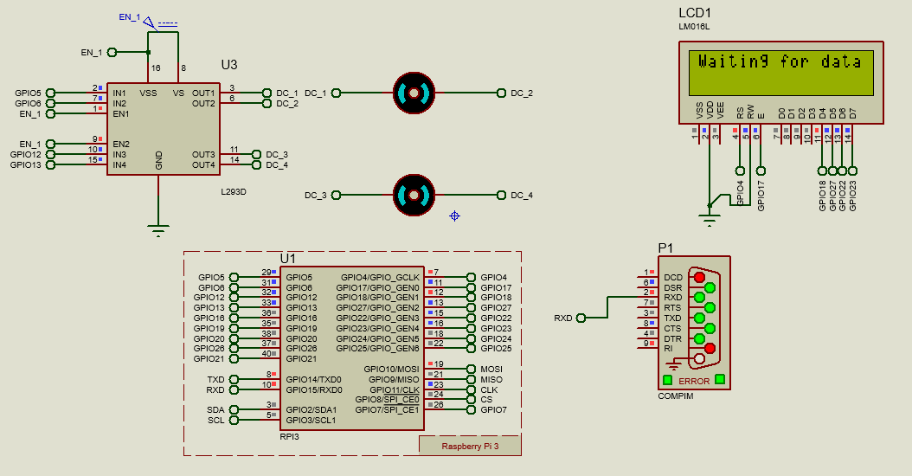
SIMULATION
Simulation of Smart Wheel Chair
Fig 5. Simulation Model of Smart Wheelchair

Slide 22
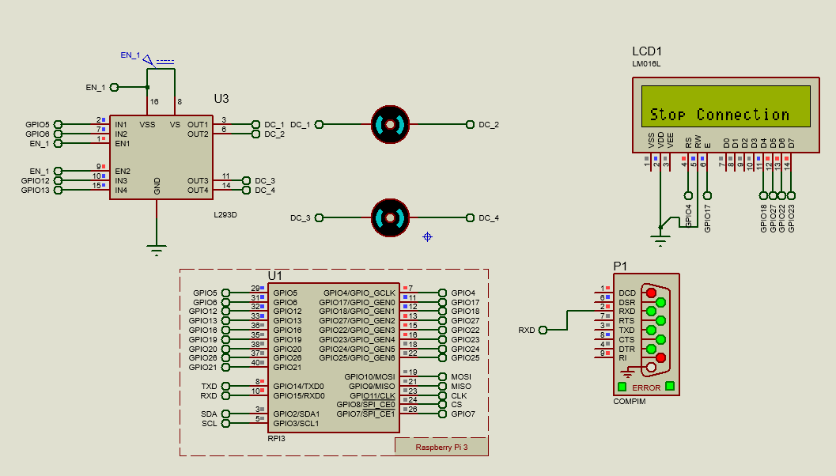
SIMULATION
Simulation of Smart Wheel Chair
Fig 6. Simulation Model of Smart Wheelchair

Slide 23
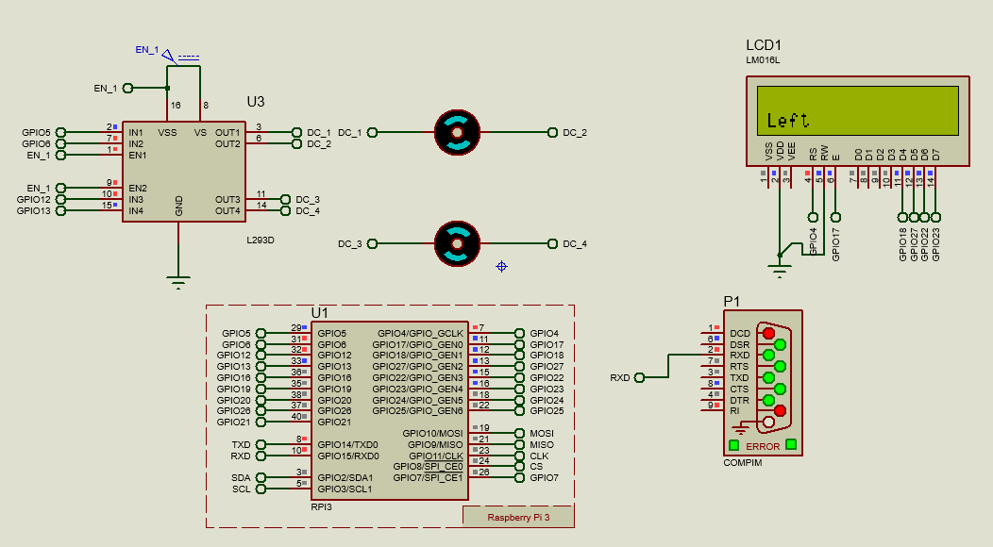
SIMULATION
Simulation of Smart Wheel Chair
Fig 7. Simulation Model of Smart Wheelchair

Slide 24
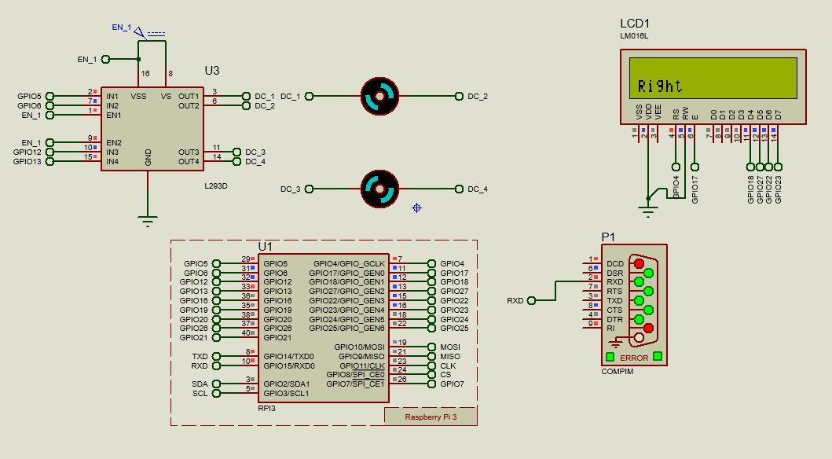
SIMULATION
Simulation of Smart Wheel Chair
Fig 8. Simulation Model of Smart Wheelchair

Slide 25
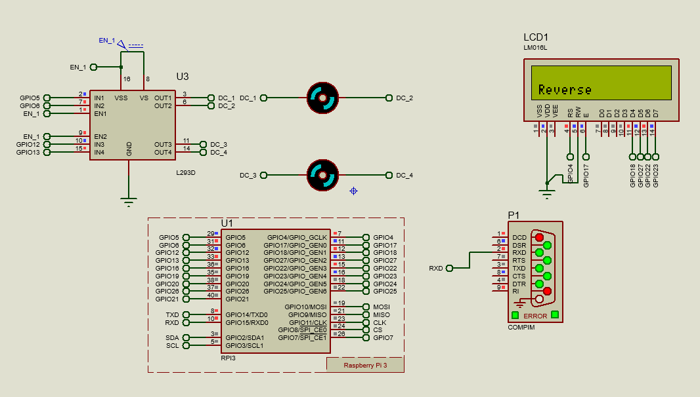
SIMULATION
Simulation of Smart Wheel Chair
Fig 9. Simulation Model of Smart Wheelchair

Slide 26
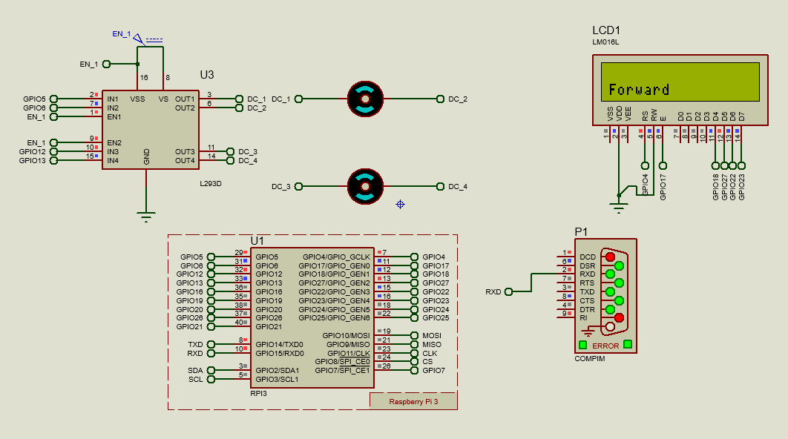
SIMULATION
Simulation of Smart Wheel Chair
Fig 10. Simulation Model of Smart Wheelchair

Slide 27
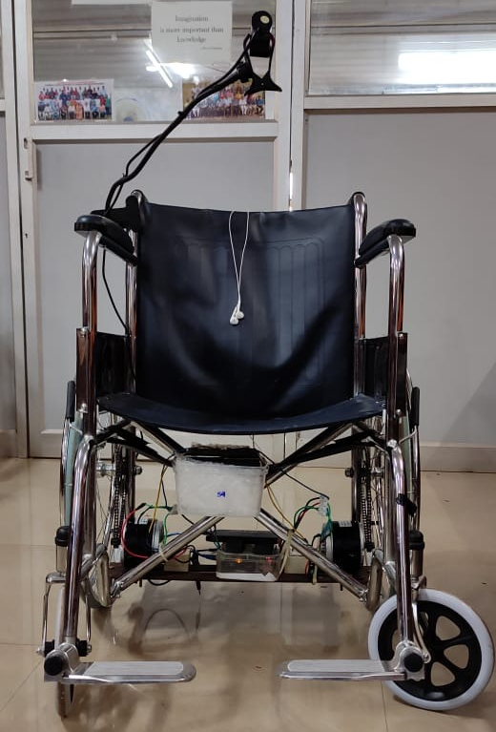
PROTOTYPE
Implementation of smart wheelchair
Fig 7. Smart wheelchair

Slide 28
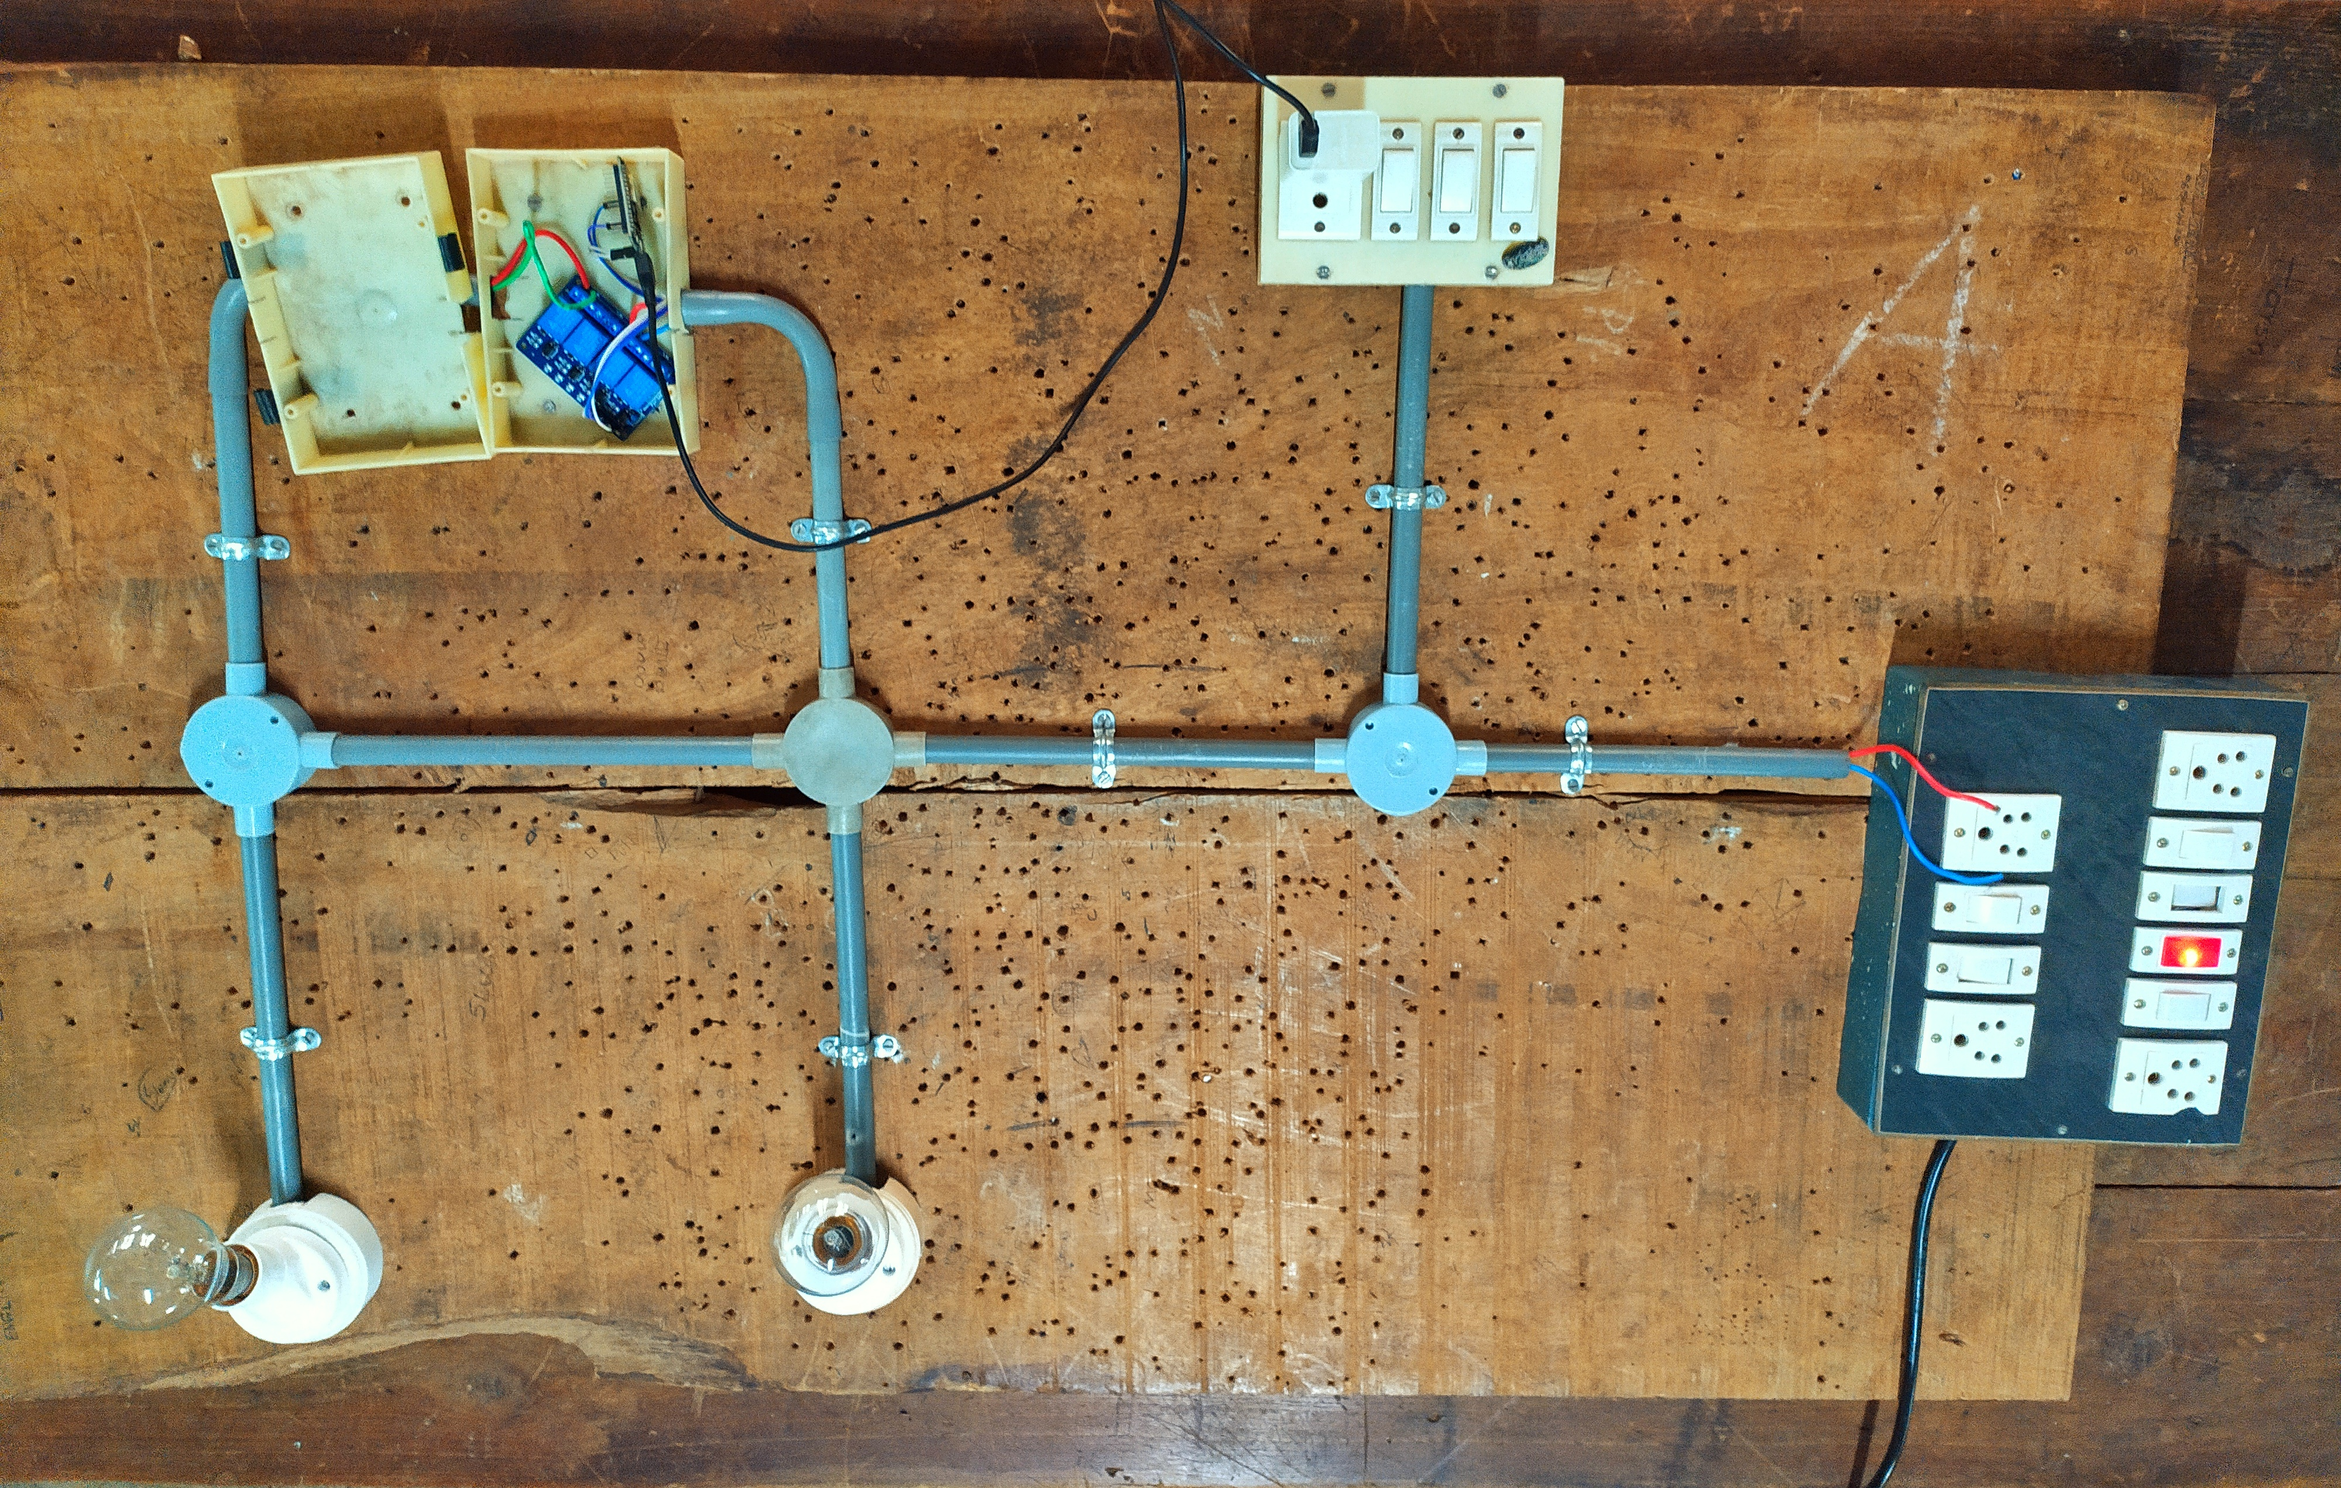
PROTOTYPE
Implementation of Home Automation System
Fig 8. Home Automation System

Slide 29
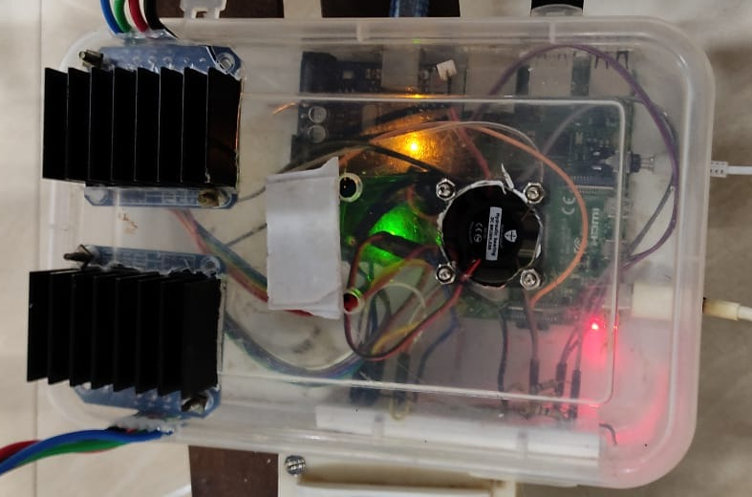
PROTOTYPE
Hardware setup for eye tracking and wheelchair control
Fig 9. Wheelchair control
unit

Slide 30
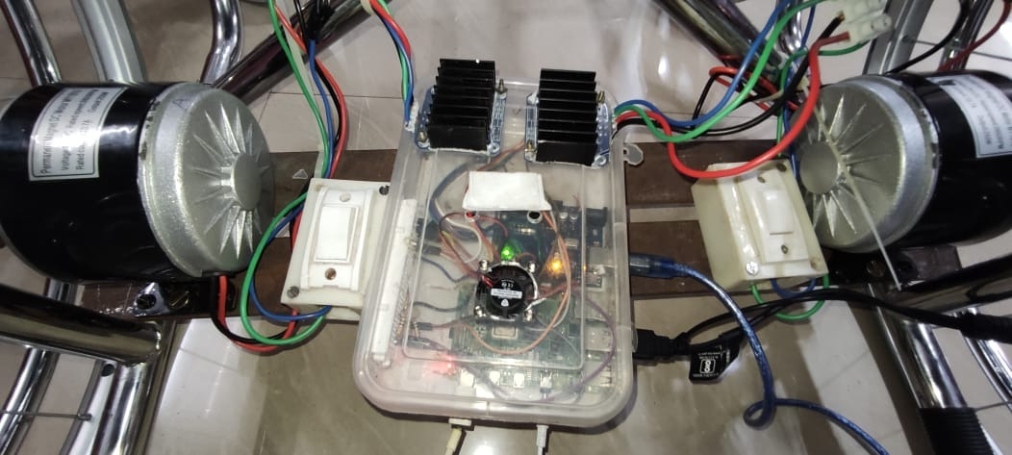
PROTOTYPE
Conversion to electric wheelchair.
Fig 10. Electric conversion
of wheelchair

Slide 31
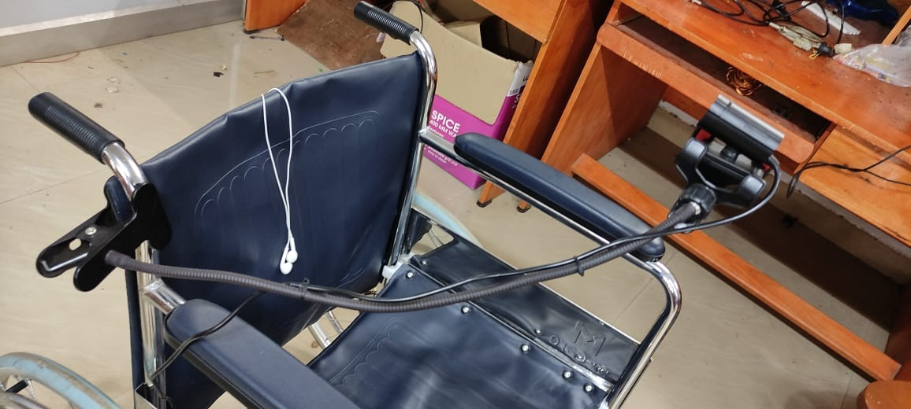
PROTOTYPE
Camera arrangement in wheelchair
Fig 11. Camera setup

Slide 32
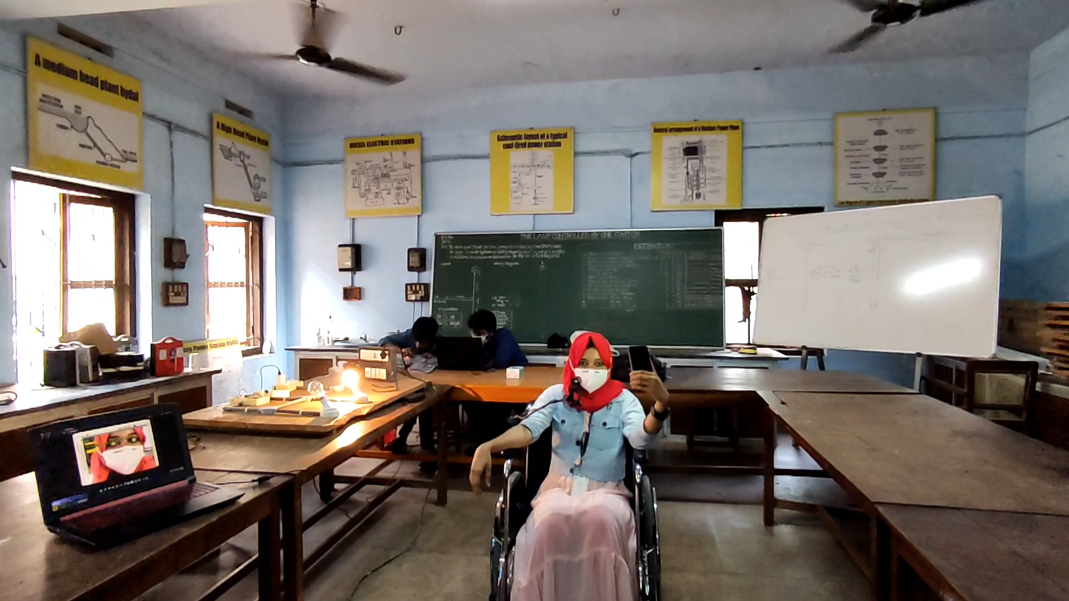
WORKING OF WHEELCHAIR
Forward movement of wheelchair

Slide 33
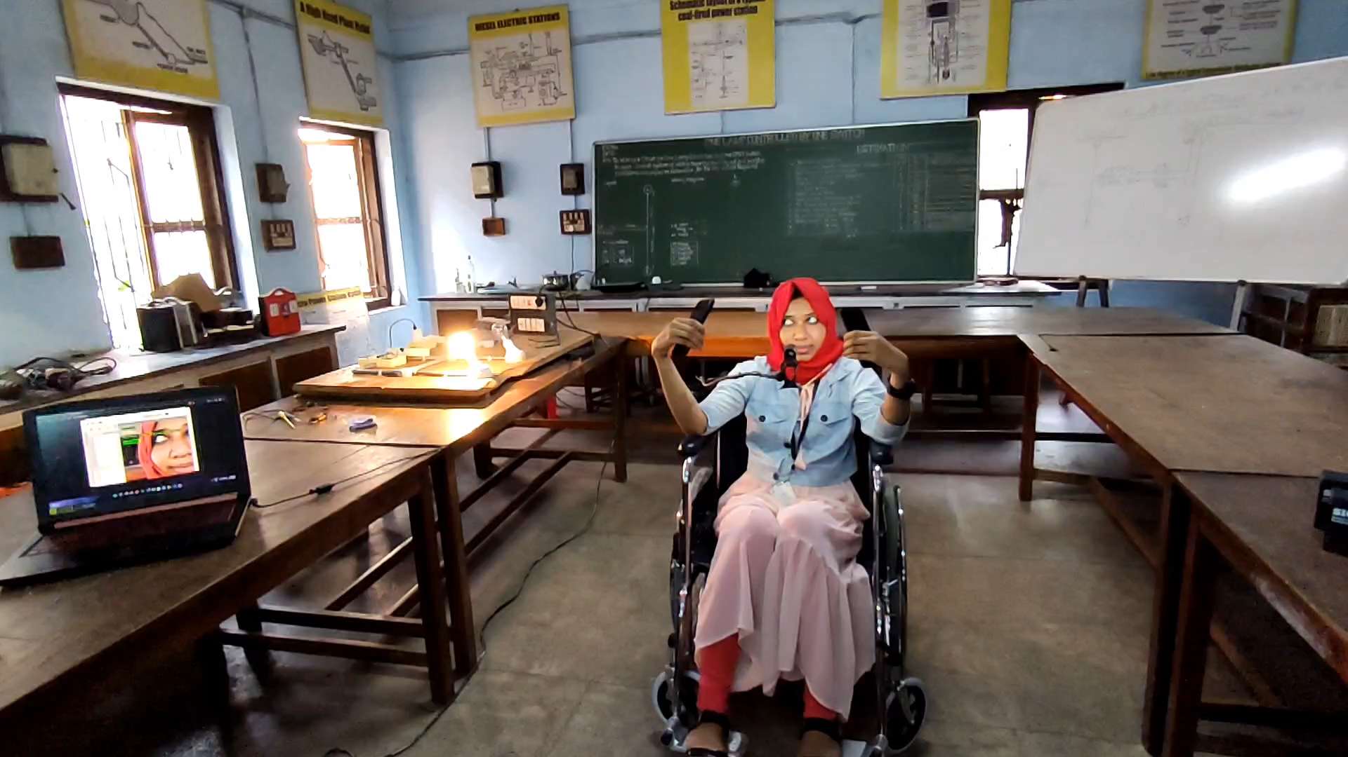
WORKING OF WHEELCHAIR
Left movement of wheelchair

Slide 34
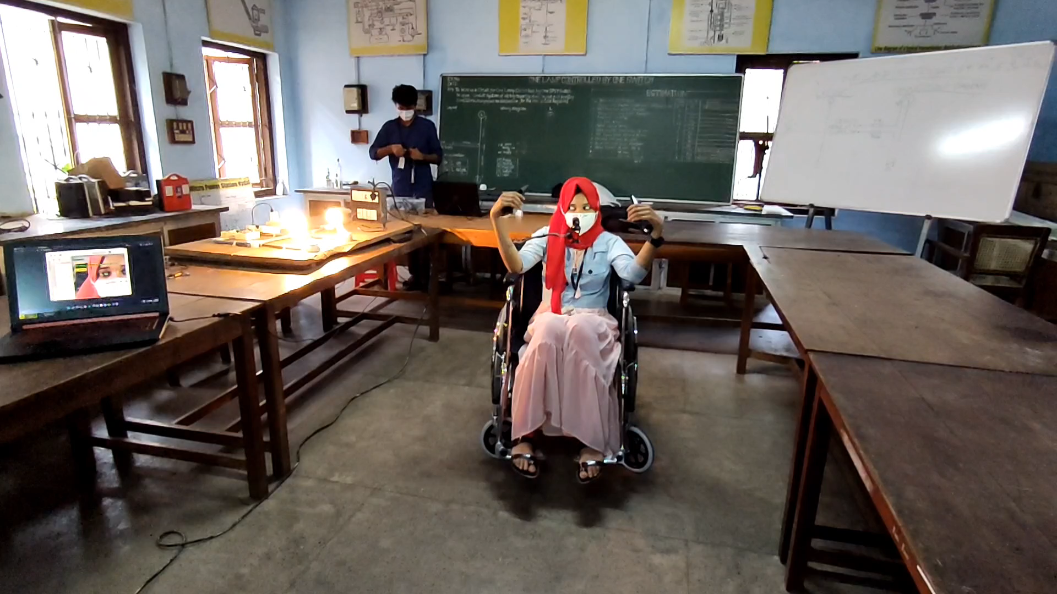
WORKING OF WHEELCHAIR
Right movement of wheelchair

Slide 35
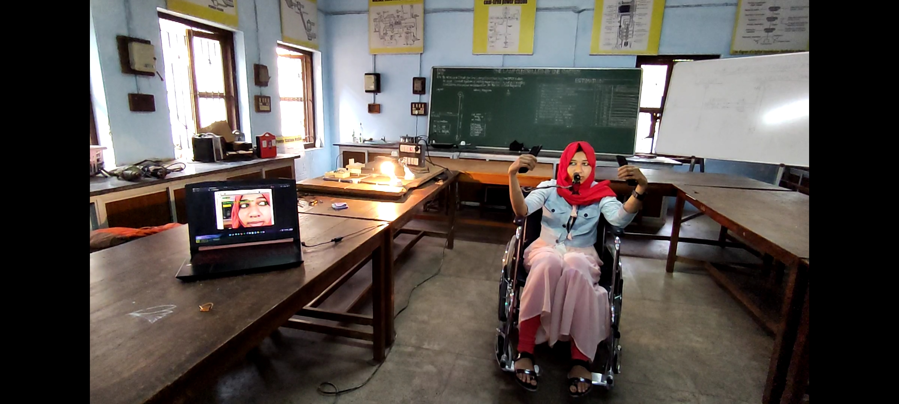
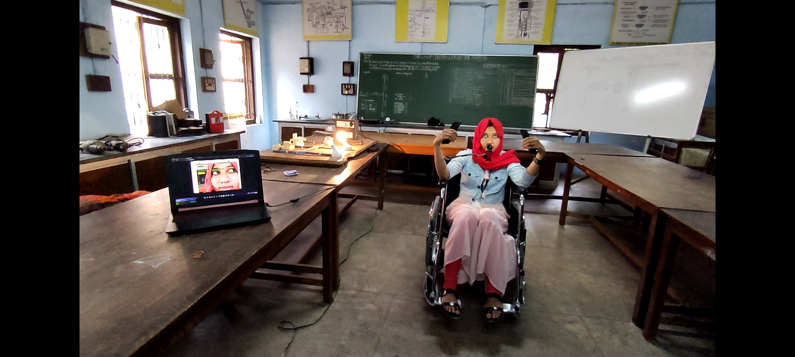
WORKING OF WHEELCHAIR
Home automation by eye tracking.
Fig 12. First bulb control
Fig 13. Second bulb Control

Slide 36
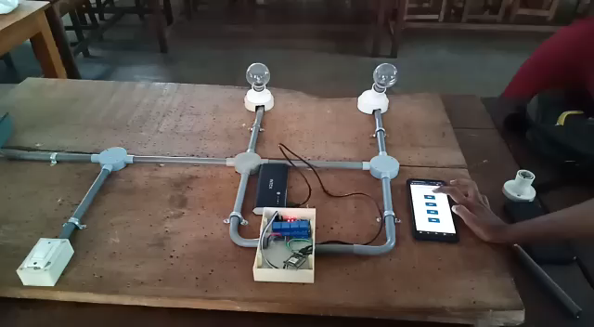
WORKING OF WHEELCHAIR
Home automation by using web server.

Slide 37
ESTIMATION OF COMPONENTS
SL No. | Component Name | Quantity | Price
1 | 250W, 24V, 13.7A Motor | 2 | 4600
2 | 4 Channel Relay(Peak 30V DC Supply) | 1 | 240
3 | 12V, 7.2Ah Battery | 4 | 3000
4 | 15V,2.2A Battery Charger | 1 | 250
5 | Node MCU | 1 | 500
6 | Ultrasonic Sensors | 4 | 400
7 | DC Wire Socket | 1 | 10
8 | Raspberry Pi 4 | 1 | 5100
9 | Webcam | 1 | 1500
10 | Wheelchair | 1 | 7000

Slide 38
ESTIMATION OF COMPONENTS
SL No. | Component Name | Quantity | Price
11 | BTS7960B Bridge Motor Driver | 2 | 1600
12 | Fan | 1 | 220
13 | Sprocket and Chain | 2 | 550
14 | Tripod | 1 | 200

Slide 39
LIMITATIONS
Detection is difficult in dim light.
Chain and sprocket system is not efficient.
Detection is difficult for users wearing spectacles and eye liner.
Breaking is not provided.

Slide 40
FUTURE SCOPES
Use of night vision cameras helps in dim light instead of normal camera.
Use of hub motors improves the efficiency of the wheelchair.
Breaking with the help of position sensors in the wheels.

Slide 41
CONCLUSION
Designed and implemented the electric smart wheelchair.
Wheelchair is controlled by tracking eye movement.
The basic devices like fan, bulb, etc. can be controlled either by eye tracking or by web server.
Limitations of the wheelchair is identified.

Slide 42
REFERENCE
[1] Diksha Raj, Anish Kalra, Sreejith Krishna N, Suhriday Roy and Dr. Shreenath K N, “Wagon - The Smart Wheelchair”, JETIR, August 2021, Vol.8, Issue 8
[2] Dola Das, Prottoy Saha and Nawshin Tabassum, “Real Time Distance and Mobility Detection of Obstacles Using a Smart Multisensor Framework for Visually Impaired People”, IEEE, 2020
[3] Tan Kian Hou, Yagasena and Chelladurai, “Arduino based voice controlled wheelchair”, IEEE, 2019
[4] Ahmad F. Klaib, Nawaf . Alsrehin, Wasen Y. Melhem, Haneen Bashtawi, Aws A. Magableh, “Eye Tracking Algorithms, Techniques, Tools, and Applications with an Emphasis on Machine Learning and Internet of Things Technologies”, September 2020.

Slide 43
REFERENCE
[5] Mohammed Hayyan Al Sibai, Sulastri Abdhul Manap, “A Study on Smart Wheelchair Systems”, Research Gate Dec 2015

Slide 44
THANK YOU

Slide 45
WHEEL CHAIR DESIGN
During the movement of a wheelchair, there are some resistances that appear.
Rolling resistance
Aerodynamic resistance
Inertial resistance

Slide 46
Calculation of Rolling Resistance
When an unformulated wheel is wrapped in unformed ground or, respectively, a fully resilient wheel is wound on a fully developed ground, there is no resistance to the movement.
In reality both the ground and the wheel suffer from deformations.
T_{r} = N×a ------(1)
To balance this torque, it is necessary to develop a torque opposite to this.
This torque equals the product of the pulling force F_{r} and the dynamic radius of the wheel.

Slide 47
Calculation of Rolling Resistance
Vertical force (F_{z}) which expresses the mass of a body in strength equals to:
F_{z} = m×g -----------(2)
where m is the body mass and g is the acceleration of gravity.
The rolling resistance F_{r} is described by the following formula:
F_{r} = F_{z} × μ_{r} ------------(3)
Where μ_{r} is the rolling resistance coefficient which is estimated for the wheelchairs with non- pneumatic wheels on concrete, with the value of
μ_{r} = 0.015.

Slide 48
Calculation of Rolling Resistance
For the calculation of the wheelchair rolling resistance is taken into account the masses of :
Wheelchair, m₁ = 7kg
User, m₂ = 100kg
Battery, m₃ = 2×2.5kg = 5kg
Motor, m₄ = 2×2.35kg = 4.7kg
Auxiliary weight, m₅ = 200g
Total weight, M= m₁+m₂+m₃+m₄+m₅
= 7+100+5+4.7+0.2 = 116.9kg ≈ 117kg

Slide 49
Calculation of Rolling Resistance
F_{z} = M ×g ----------(4)
F_{z} = 117 × 9.81
F_{z} = 1147.77 N
M is the total mass in kilogram
F_{r} = F_{z}×μ_{r} ------------(5)
F_{r} = 1147.77 × 0.015
F_{r} = 17.2 N

Slide 50
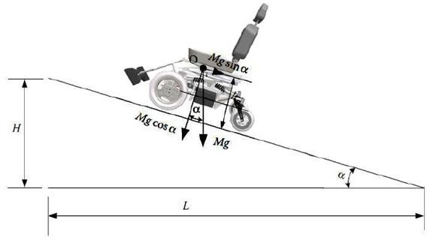
Calculation of Rolling Resistance
When climbing a vehicle due to road inclination, a resulting force from the weight of the vehicle appears as shown in Fig 1.
This force opposes the movement of the vehicle when it is on the hill.
Fig 1. Forces in road inclinations.

Slide 51
Calculation of Rolling Resistance
The ascent resistance F_{B} is calculated from the following formula:
F_{B}=F_{z}× Sin α--------------(6)
Where F_{z} is vertical force in newtons and α is the angle of the road inclination.
Tilt of the road is the ratio of the height H to the distance L (Fig 1) and expresses the height to be developed at a distance of 100 km:
Ι = Η/L = tan α ≈ sin α------------(7)
To find the angle α, in order to calculate the ascent resistance, the right formula is the following:
Α=tan⁻¹(i)

Slide 52
Calculation of Rolling Resistance
Thus, for a pavement slope of 10º the vehicle has an ascent resistance equals to:
F_{B}= 1147.77 × Sin10 = 199.31 N
F_{total}= F_{r} + F_{B} = 17.2+ 199.31 = 216.51 N
Where F_{total} is the total traction force which is the sum of ascent resistance F_{B} and the rolling resistance F_{r}
The torque needed on the wheel to overcome these resistors is calculated by the formula:
F_{t} = M_{k} × i_{tot}/r_{t} => M_{k} = F_{t} × r_{t} / i_{tot}
Where M_{k} is the torque on the wheel in Nm

Slide 53
Calculation of Rolling Resistance
The r_{t} the radius of the wheel and i_{tot} its gear transmission ratio from the motor to the wheel.
The motors have a diameter of 12inch (308mm) with a working voltage of 24V, 250Watt and a fixed gear transmission ratio of 23: 1.
The maximum torque that can be produced by the motor according to its operating diagram is 20Nm and is enough to overcome the climb and roll resistors.
F_{t} = M_{k} × i_{tot} / r_{t}
M_{k} = F_{t} × r_{t} / i_{tot}
= 22 × 0.154 / 23
= 1.5 Nm

Slide 54
Calculation of Rolling Resistance
According to standard values maximum speed of motor is 220 rpm and the maximum speed that the wheelchair can develop is 12Km/h.
This is calculated by the following formula:
N = V × 60/2 × π × r
V = n × 2 × π × r / 60
= 216.51 × 2 × π × 0.154/60
V = 3.50 m/s
V = 12.6 Km/h
Where V is the maximum speed that wheelchair can achieve in Km/h, n is motors speed in rpm and r is wheelchair’s wheel radius in m.

Slide 55
Calculation of Power
Work results when a force acts upon an object to cause a displacement (or a motion) or, in some instances, to hinder a motion.
Three variables are of importance in this definition
Force
Displacement
The extent to which the force causes or hinders the displacement
Each of these three variables find their way into the equation for work.
W=F×χ
Where W is the work in Joules, F is force in N and χ is the displacement in meters

Slide 56
Calculation of Power
Considering the above mathematical formulas and knowing the velocity it follows that:
P = F_{t}×V_{t}
Where P is the power in watts F_{t} is the traction force in N and V_{t} is the velocity in m/s.
Theoretically, the power given to the vehicle, when it moves at the maximum speed (3.54m/s) it can develop:
P = F_{t}×V_{t}
P= 17.2N × 3.50 m/s P= 60.2 Watt

Slide 57
Calculation of Power
The needed energy to drive the vehicle for one hour is calculated by the formula:
E= P×t
E = 0.0602KWh
Where E is the energy in KWh, P is power in watt and t is the time in hours.
According to the formula below, the vehicle needs 2.50Ah to move one hour at maximum speed.

Slide 58
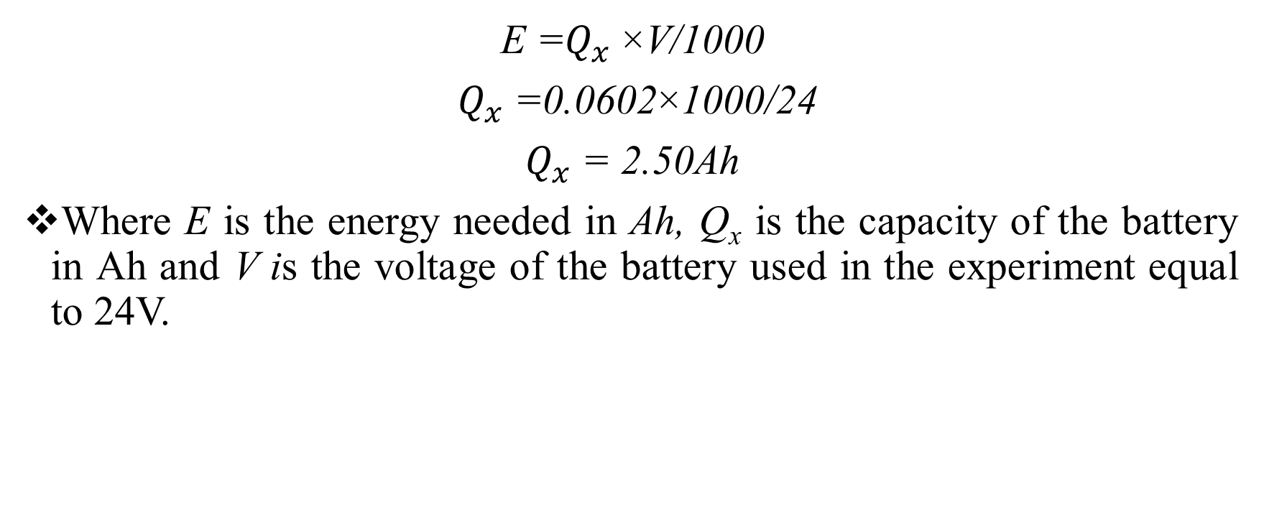
Calculation of Power
E =$Q_{x}$×V/1000
$Q_{x}$=0.0602×1000/24
$Q_{x}$= 2.50Ah
Where E is the energy needed in Ah, Q_{x} is the capacity of the battery in Ah and V is the voltage of the battery used in the experiment equal to 24V.

Slide 59
WORK DONE IN PREVIOUS SEMESTER
(S7)

Slide 60
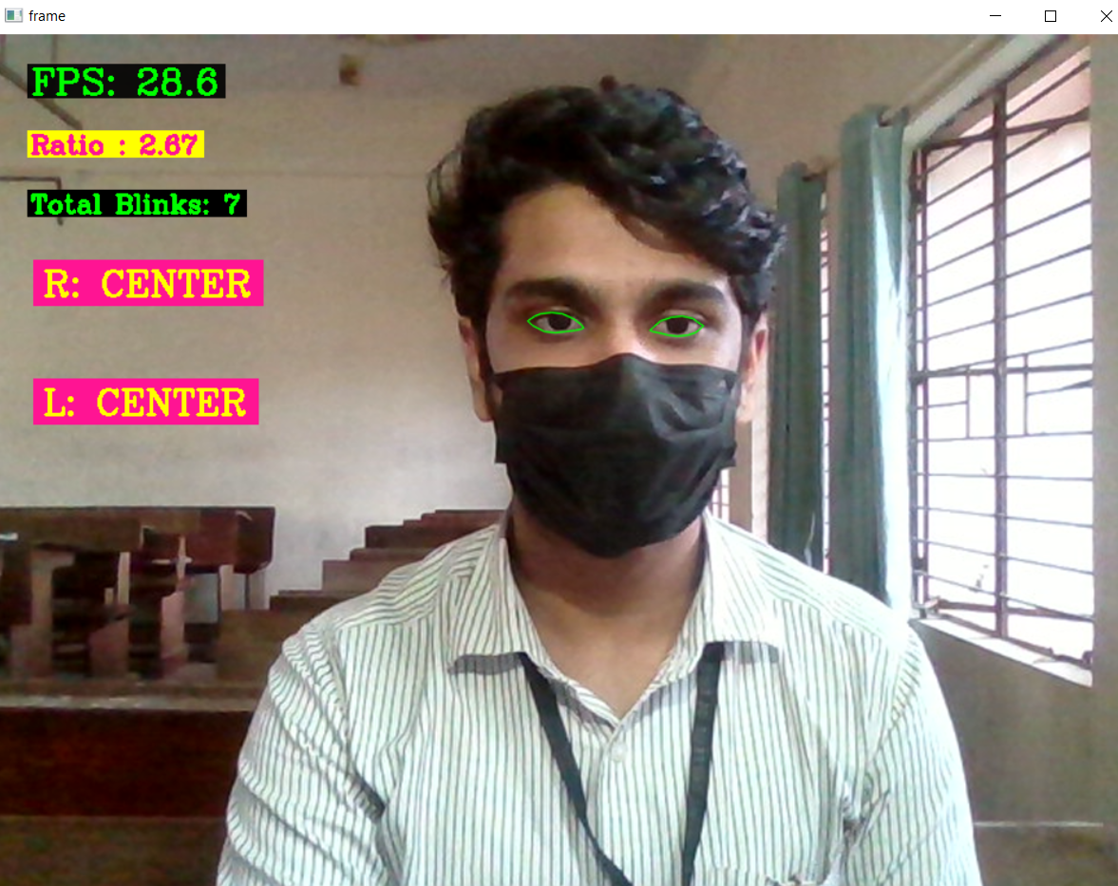
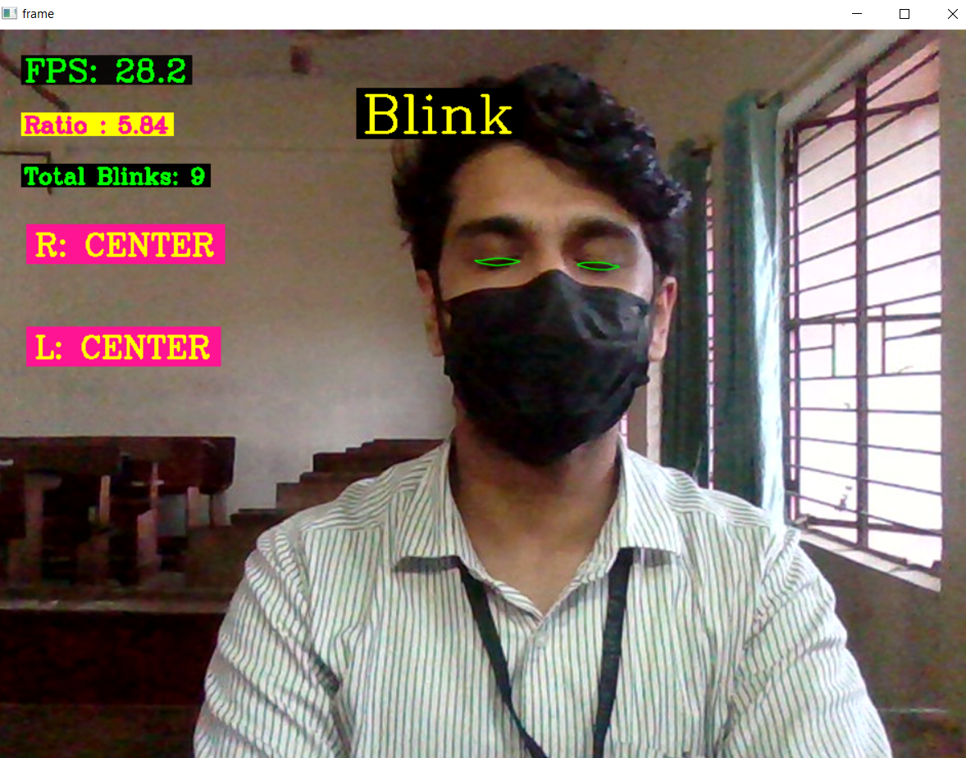
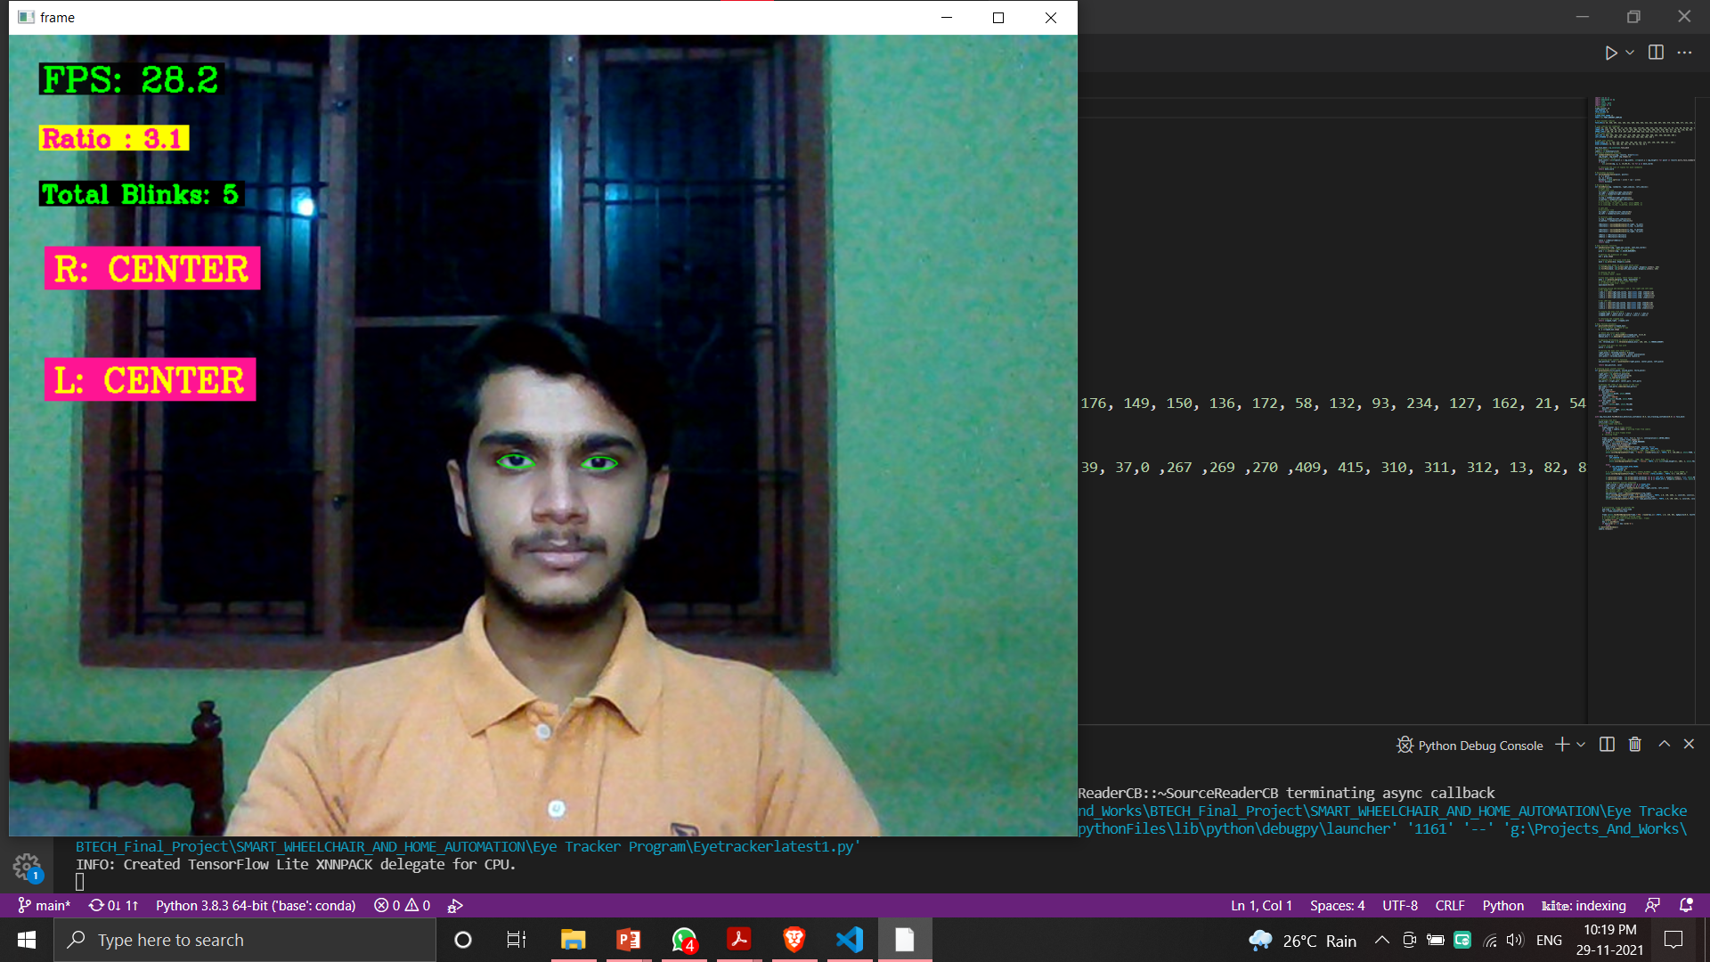
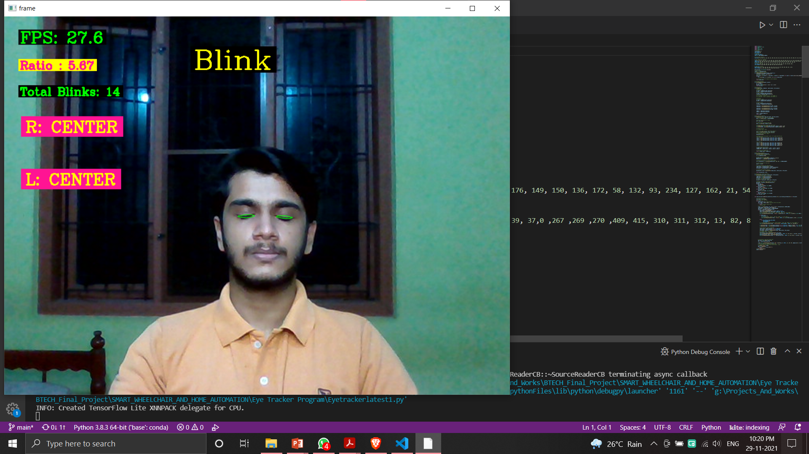
STATUS OF PROJECT WORK
Eye tracking program is developed and its results are shown below.
Fig 11.Straight
Fig 12. Closed

Slide 61
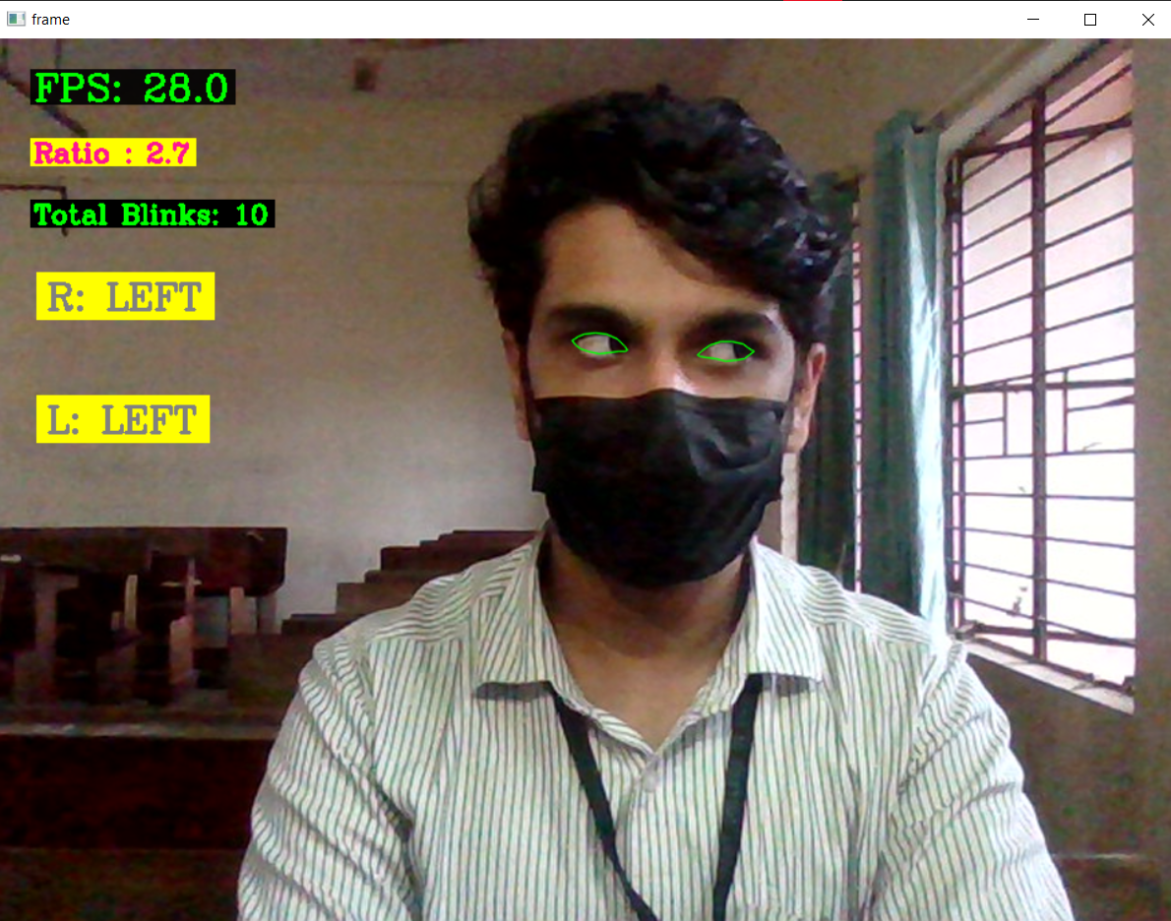
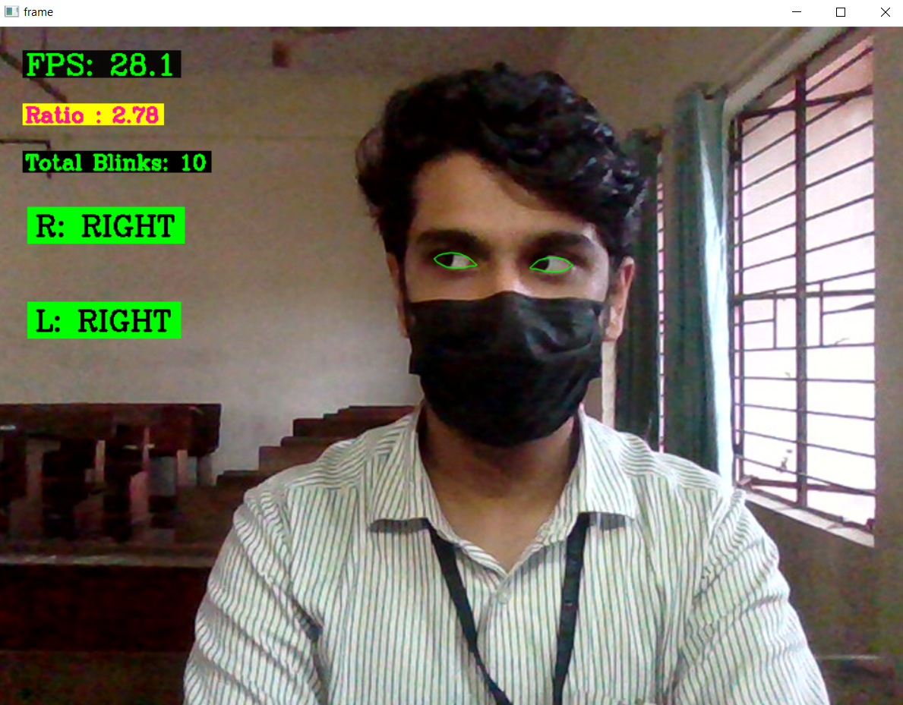


STATUS OF PROJECT WORK
Eye tracking program is developed and its results are shown below.
Fig 13. Left
Fig 14. Right

Slide 62
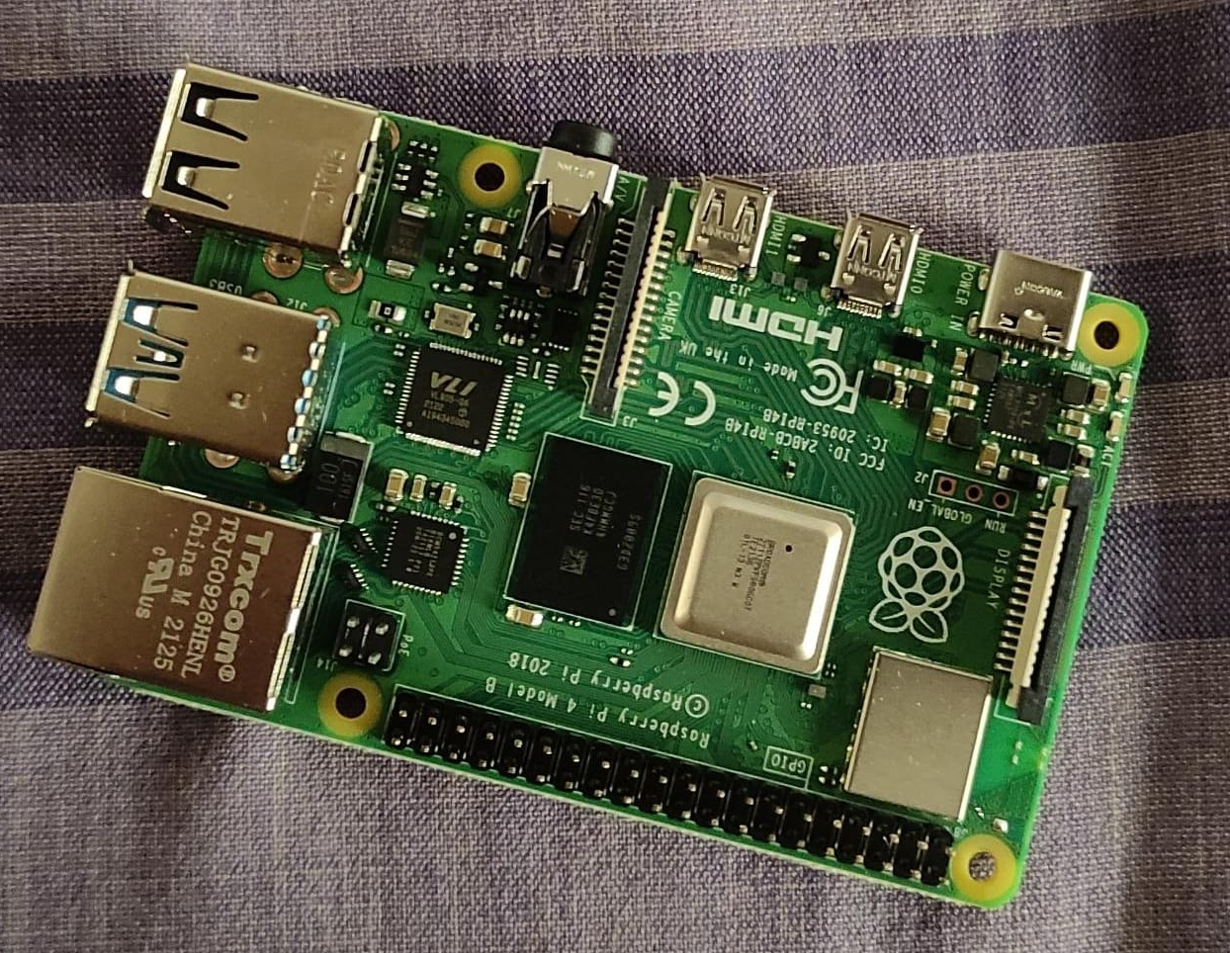
STATUS OF PROJECT WORK
Acquired and tested Raspberry Pi 4, 4GB model.
Fig 15. Raspberry Pi 4

Slide 63
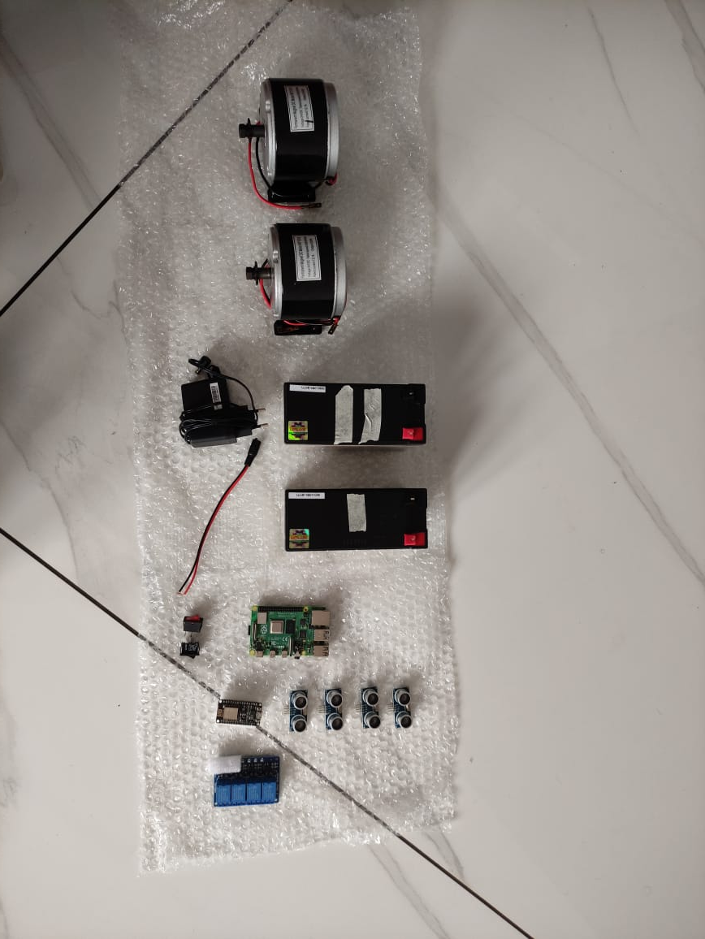
STATUS OF PROJECT WORK
Acquired and tested components of wheelchair.
Fig 2. Components

Slide 64
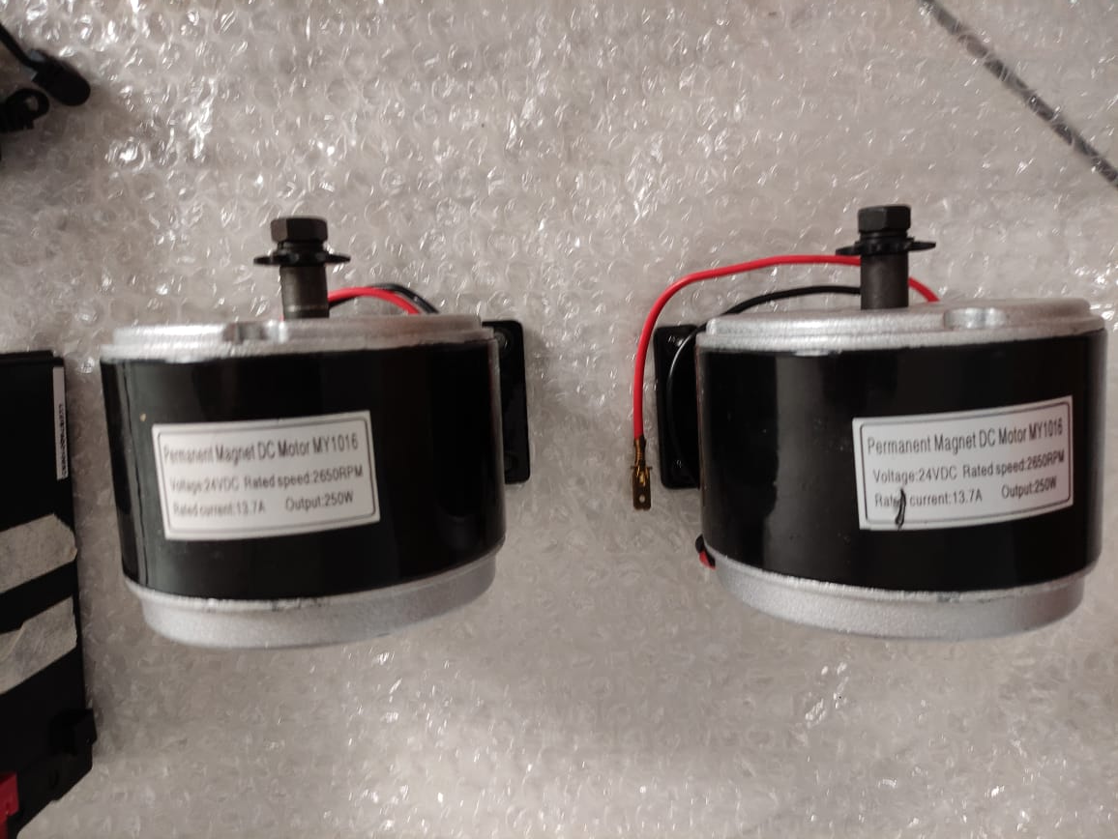
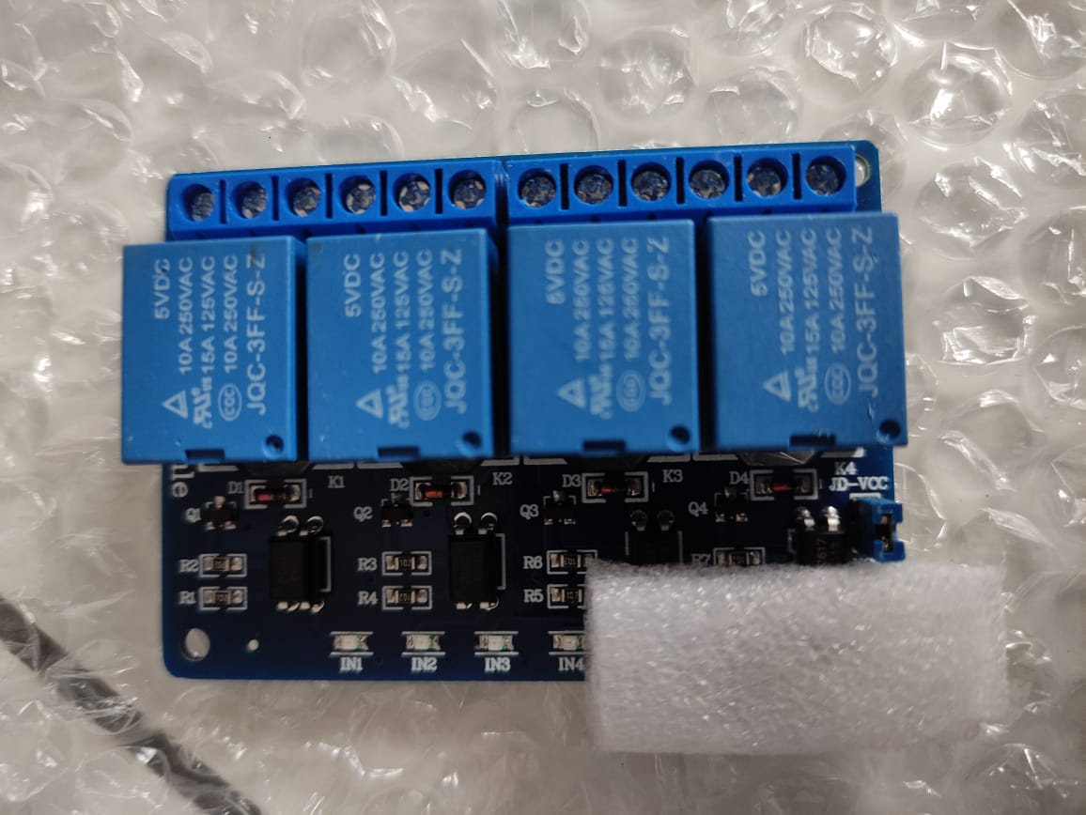
STATUS OF PROJECT WORK
Fig 3. 250W, 24V, 13.7A Motor
Fig 4. 4 Channel Relay(Peak 30V DC Supply)

Slide 65
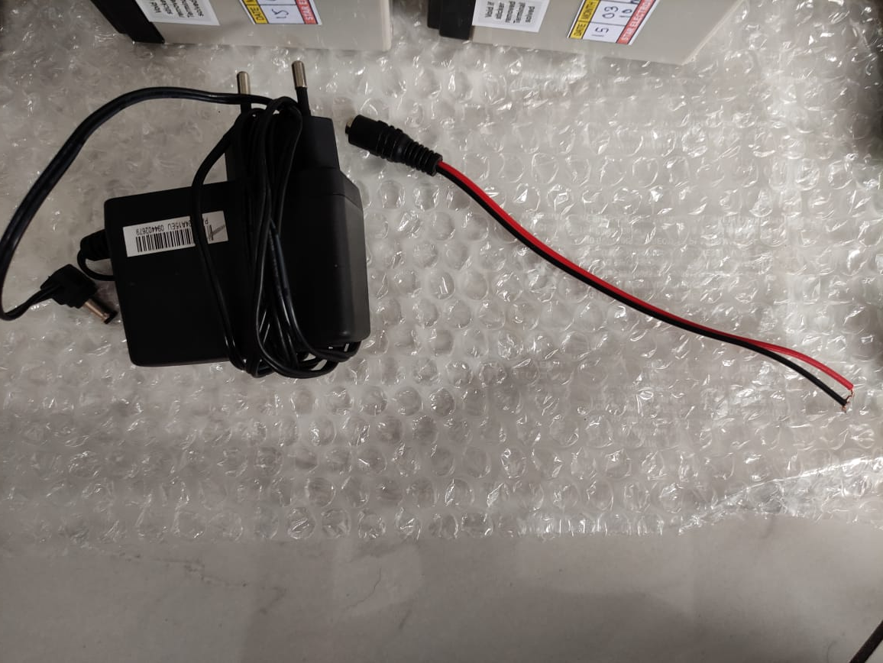
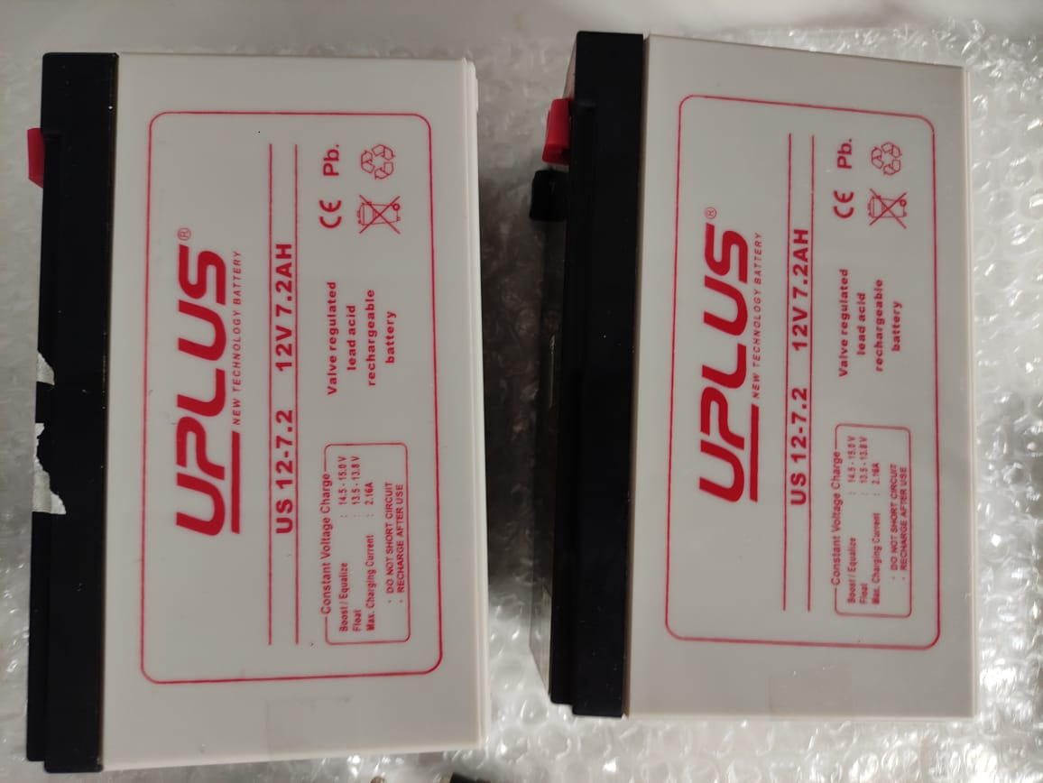
STATUS OF PROJECT WORK
Fig 5. 12V, 7.2Ah Battery
Fig 6. Battery Charger and Connector

Slide 66
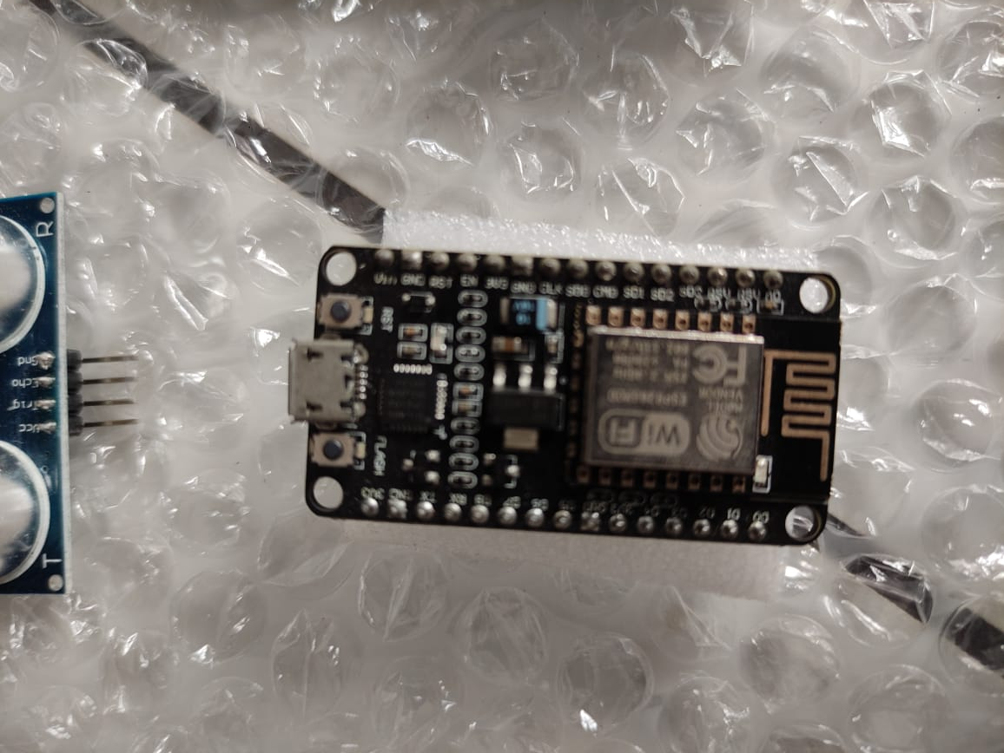
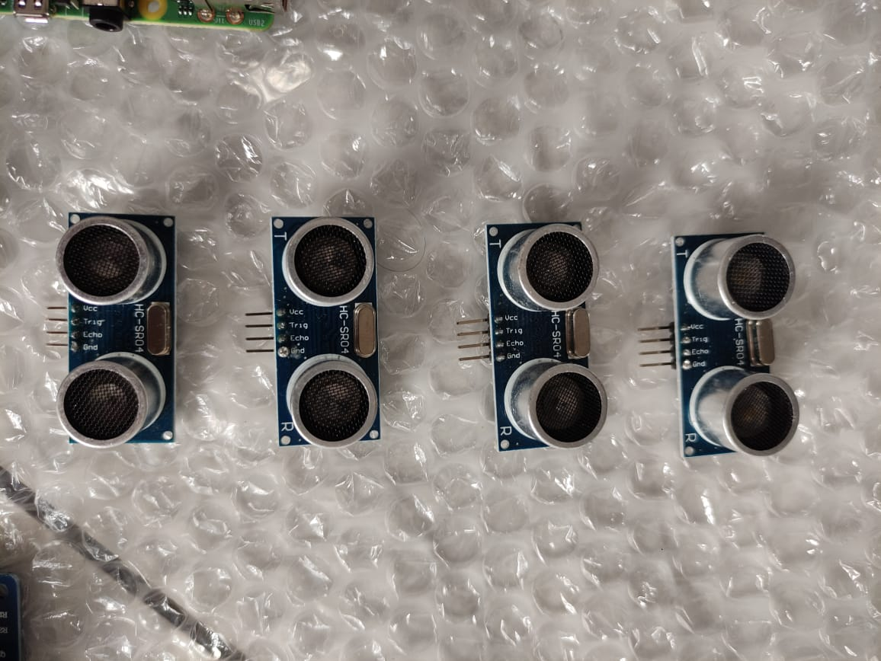
STATUS OF PROJECT WORK
Fig 7. Node MCU
Fig 8. Ultrasonic Sensors

Slide 67
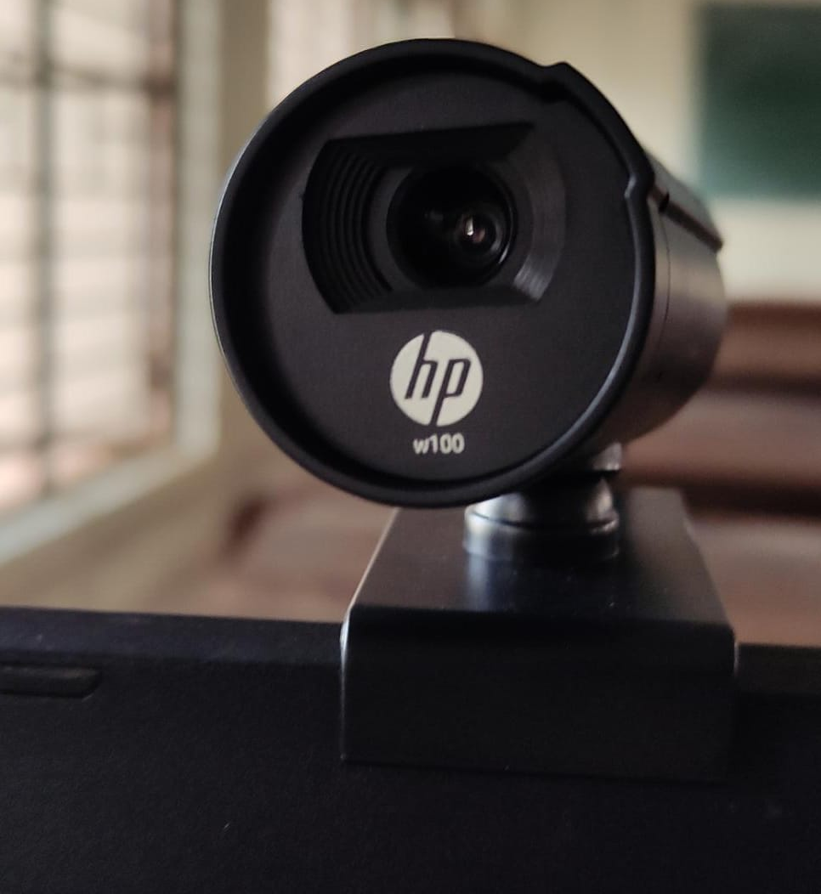
STATUS OF PROJECT WORK
Fig 9. Webcam

Slide 68
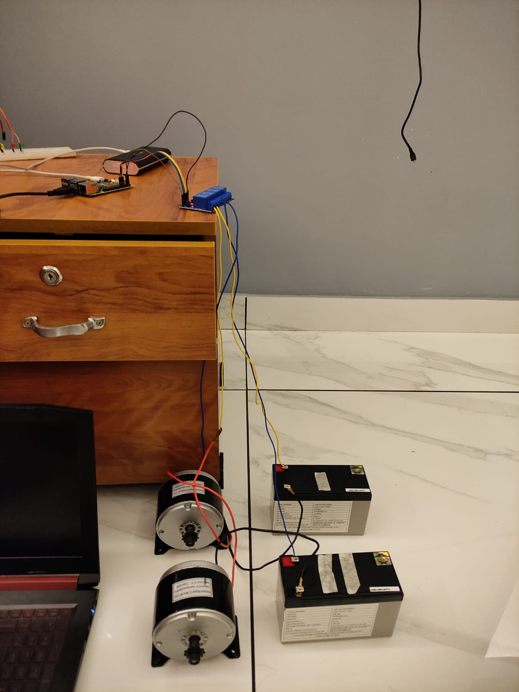
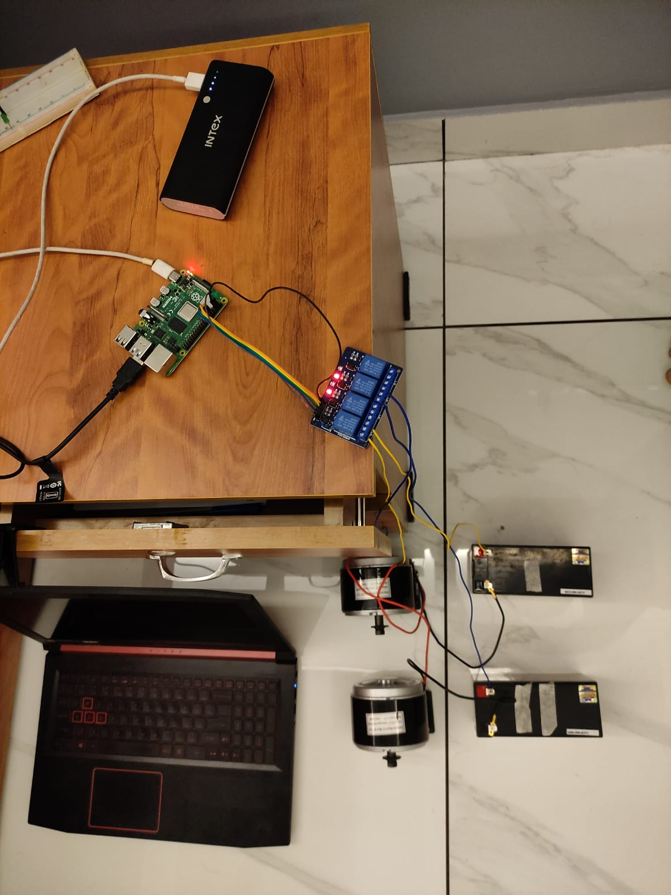
EYE TRACKING PROGRAM
Setup for Eye tracking program
Fig 12. Experimental Setup

Slide 69
WORKING OF WHEELCHAIR
Stopping of wheelchair

